Slide 1
Project 2 | CIS 418
Aveek, Reena, and Asutosh

Slide 2
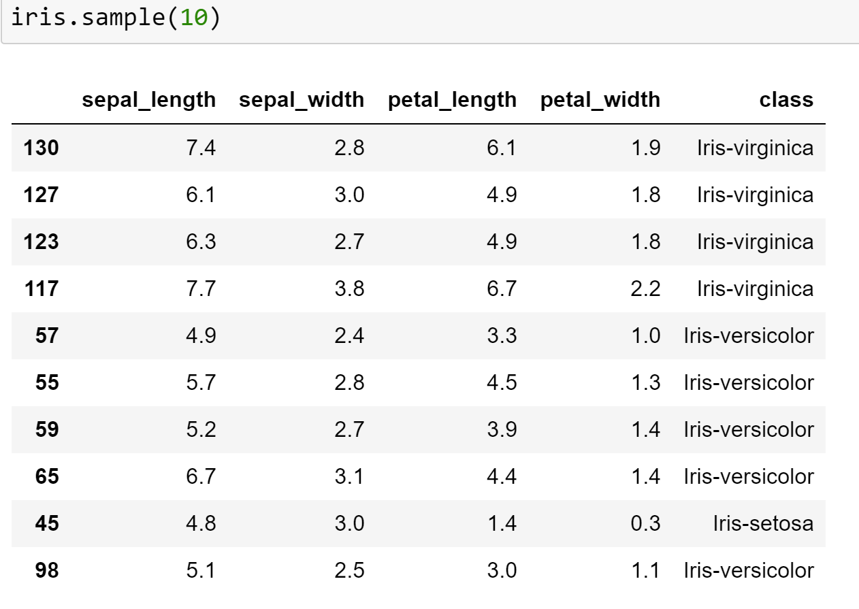
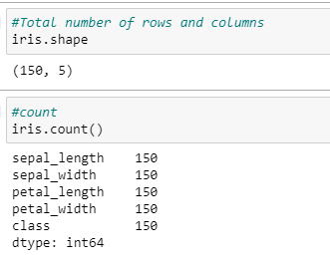
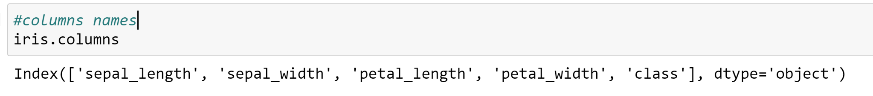
The Dataset:

Slide 3
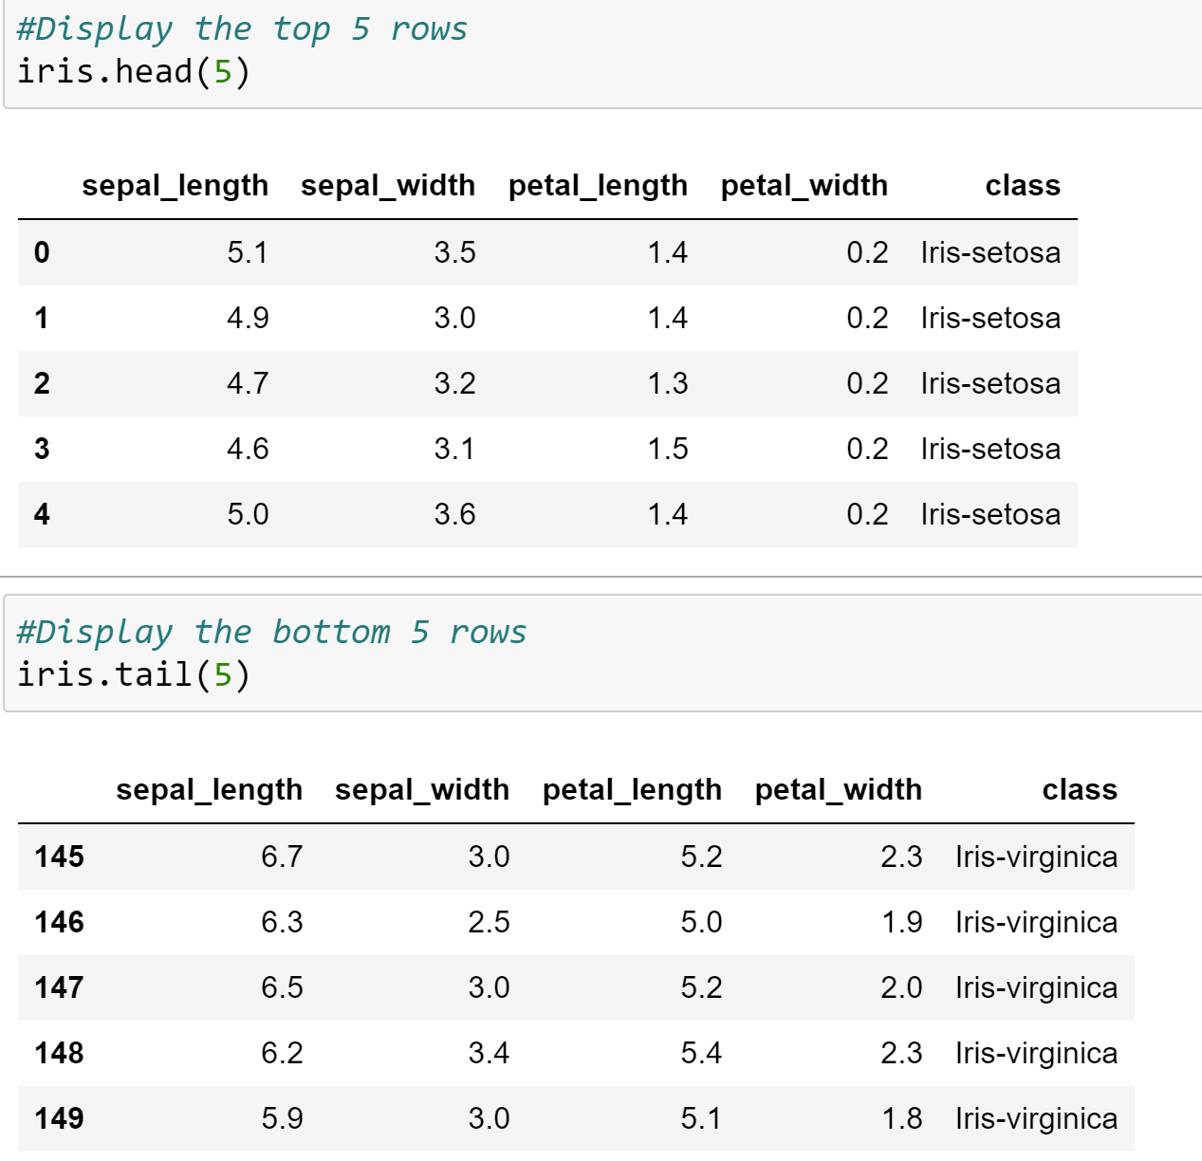
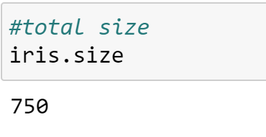
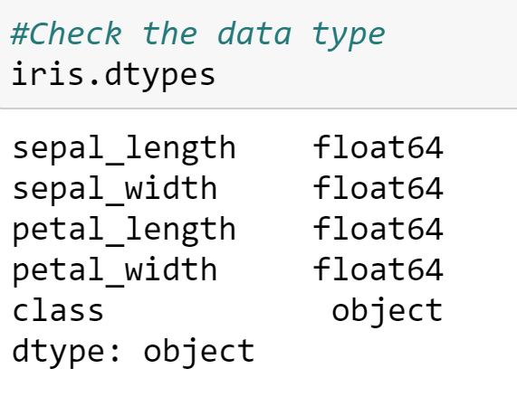
The Dataset:

Slide 4
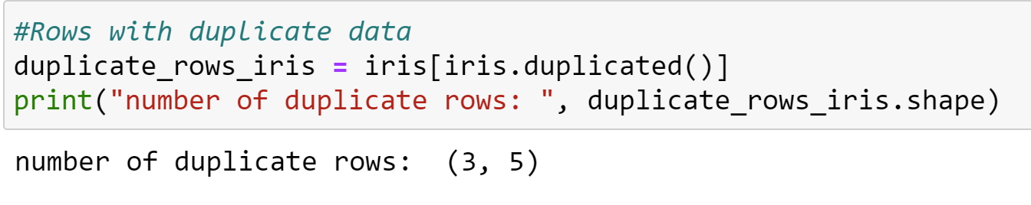
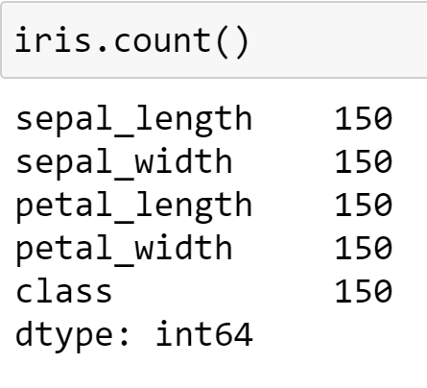
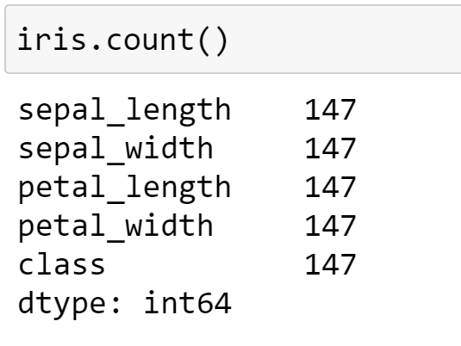
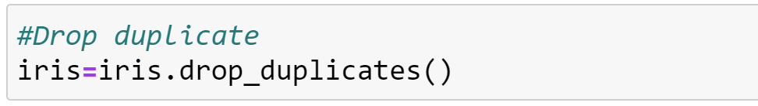
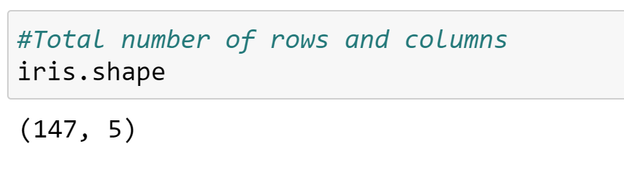
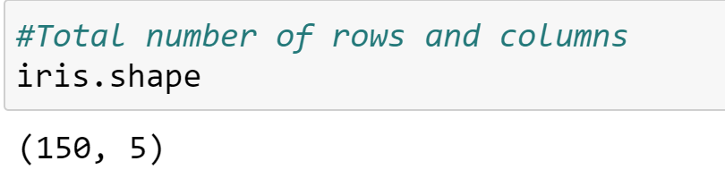
Duplicate Data Check
Before
After

Slide 5
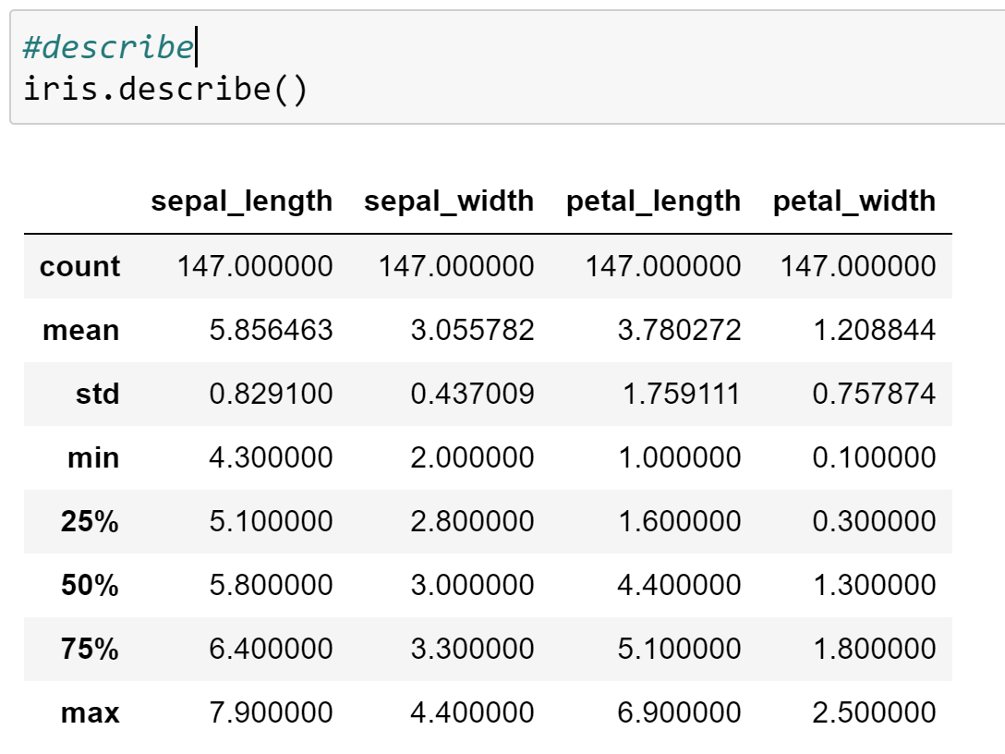
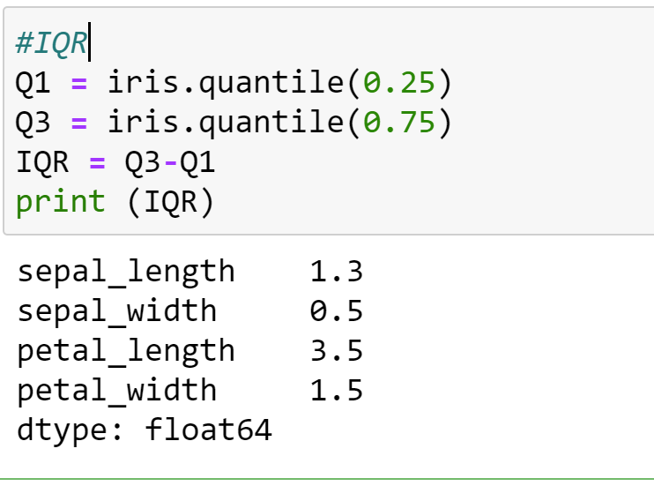
Descriptive Statistics

Slide 6
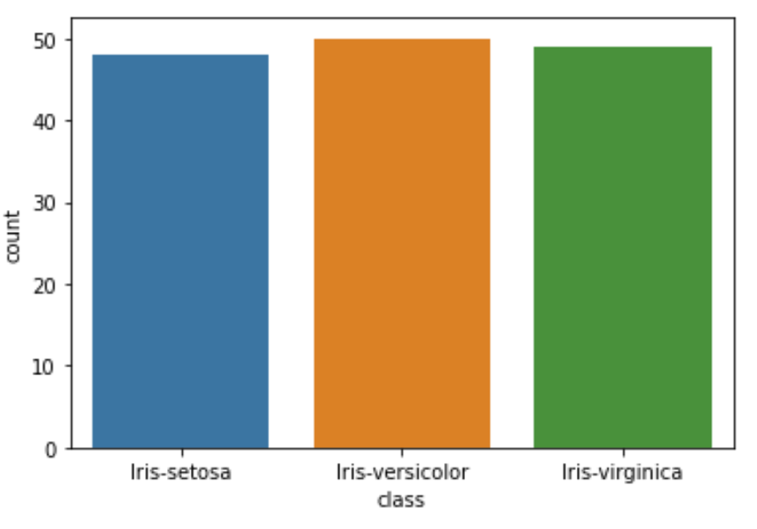
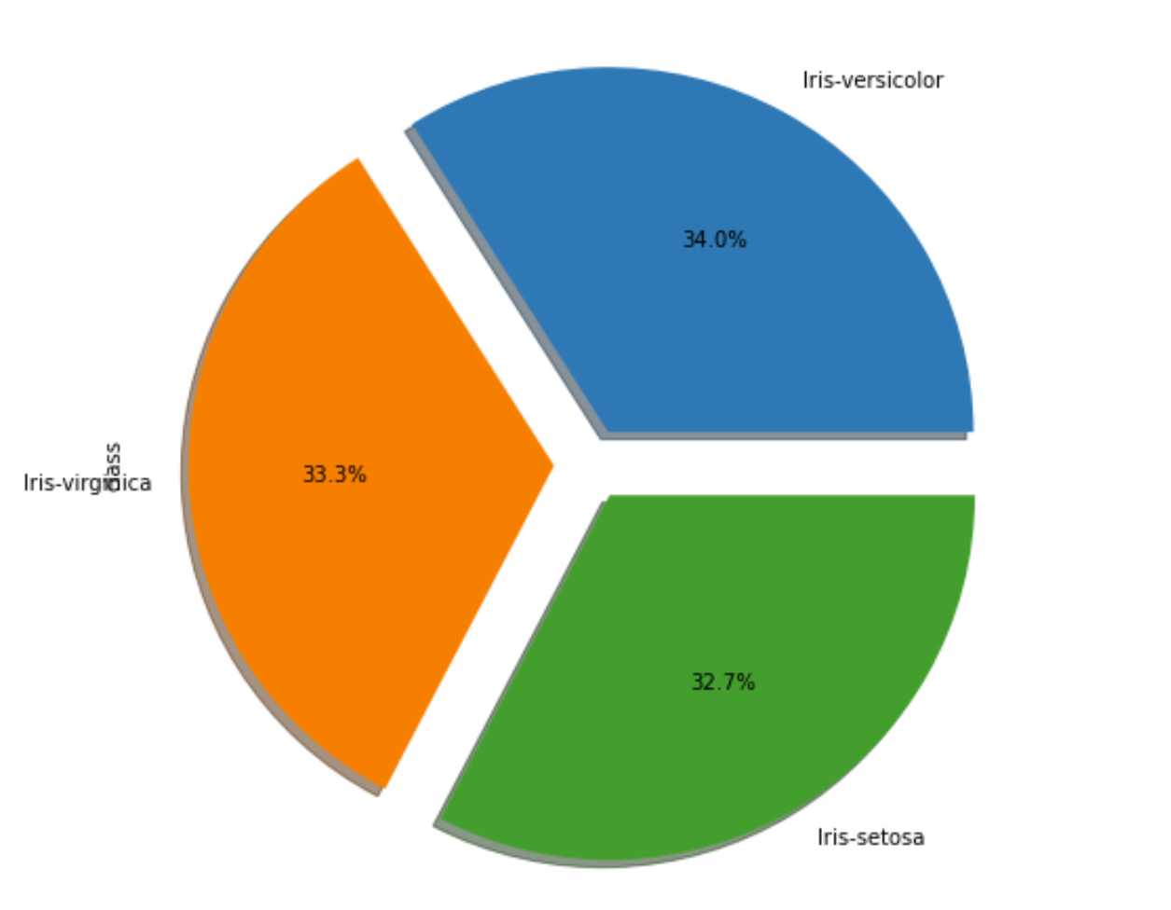
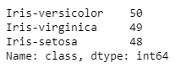
Countplot / Pie Chart

Slide 7
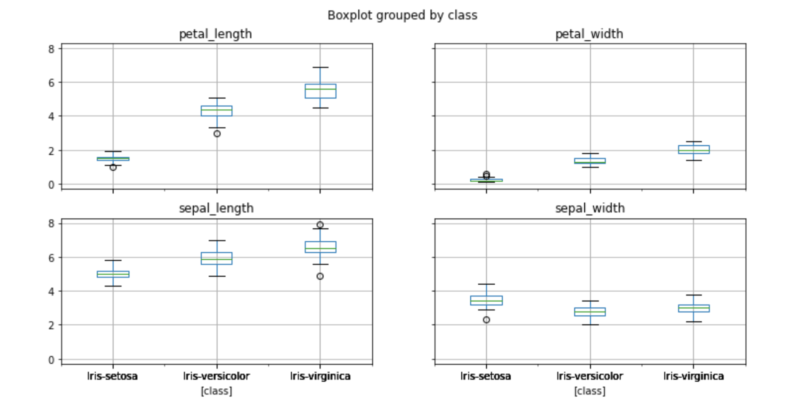
Detecting Outliers using boxplot

Slide 8
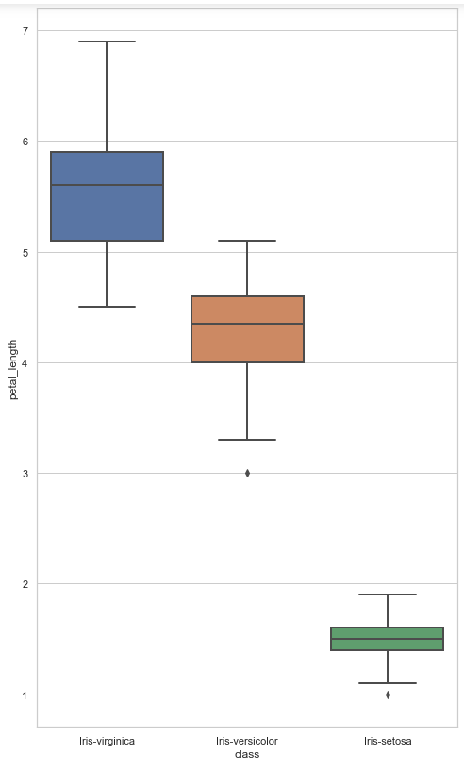
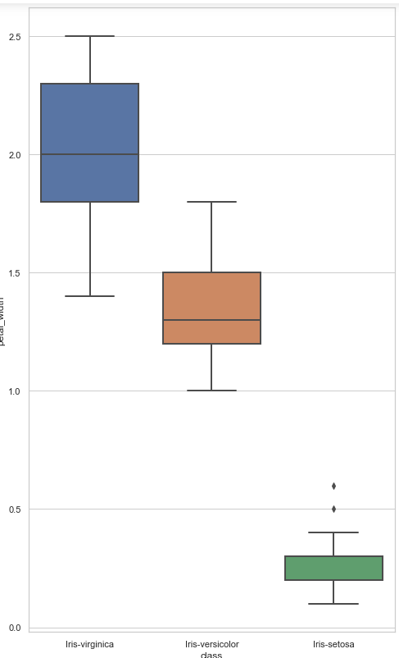
petal_length and petal_width
Top line represent the max value,top edge of box is third Quartile, middle edge represents the median,bottom edge represents the first quartile value.The bottom most line represents the minimum value of the feature.The height of the box is called as Interquartile range.The black dots on the plot represent the outlier values in the data.

Slide 9
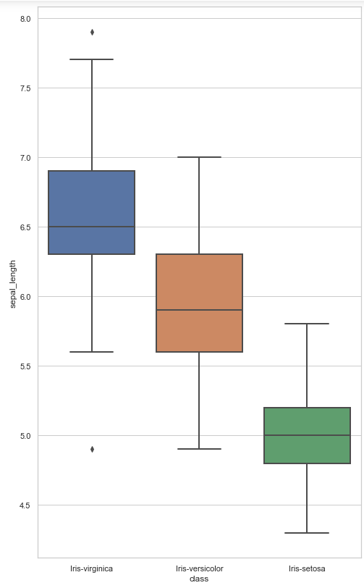
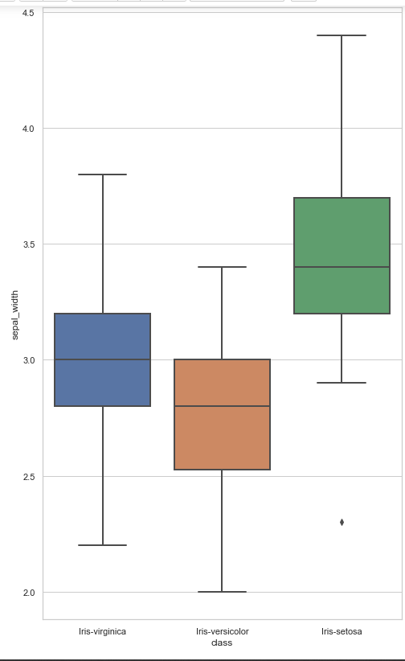
sepal_length and sepal_width
Top line represent the max value,top edge of box is third Quartile, middle edge represents the median,bottom edge represents the first quartile value.The bottom most line represents the minimum value of the feature.The height of the box is called as Interquartile range.The black dots on the plot represent the outlier values in the data.

Slide 10
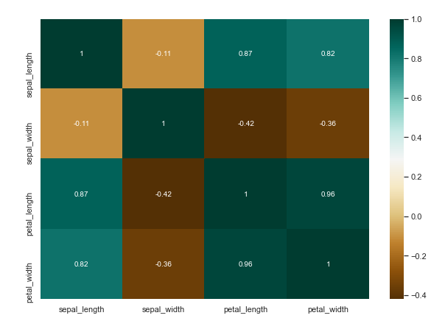
Finding Correlation using barplot
High positive or negative value shows that the features have high correlation

Slide 11
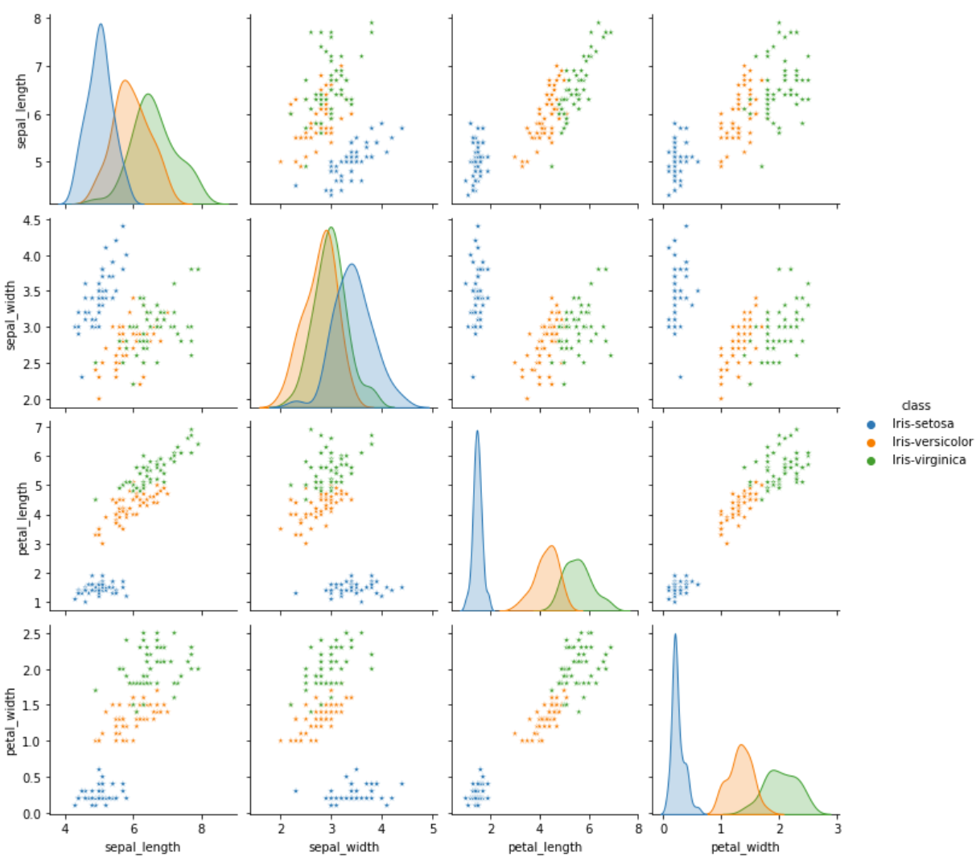
Pair plot
It is clear that the relationship between pairs of features of a Iris-setosa (in blue) is distinctly different from those of the other two species.

Slide 12
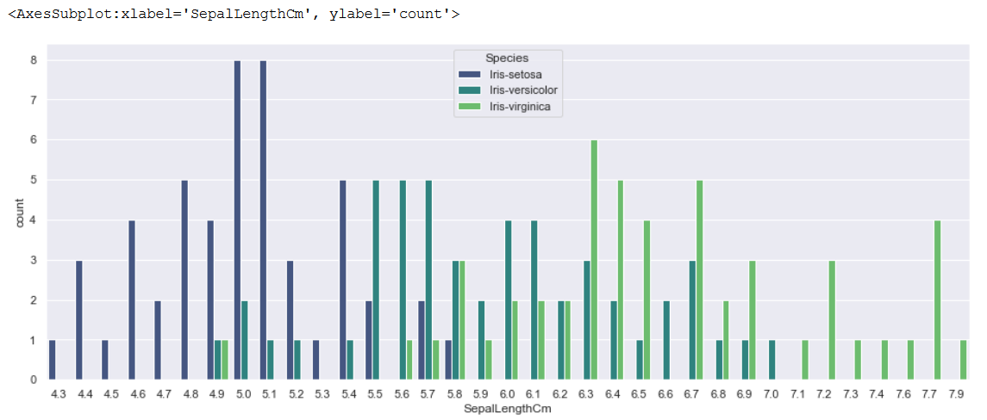
Relation: Count and SepalLengthCm

Slide 13
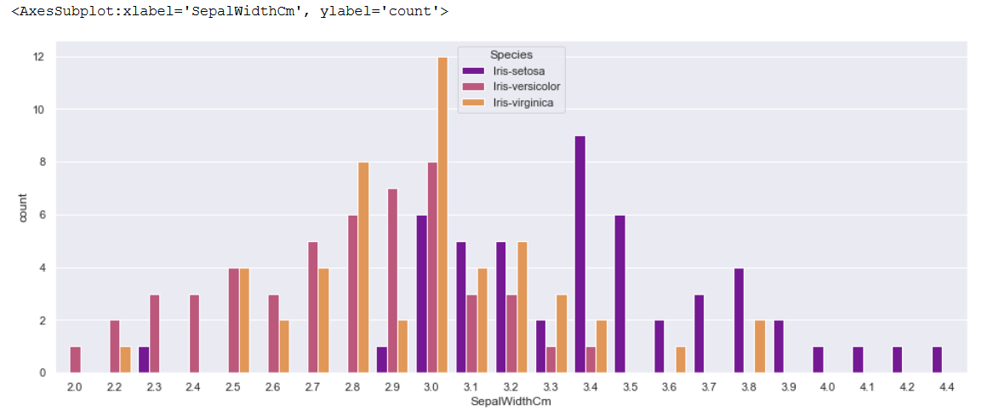
Relation: Count and SepalWidthCm

Slide 14
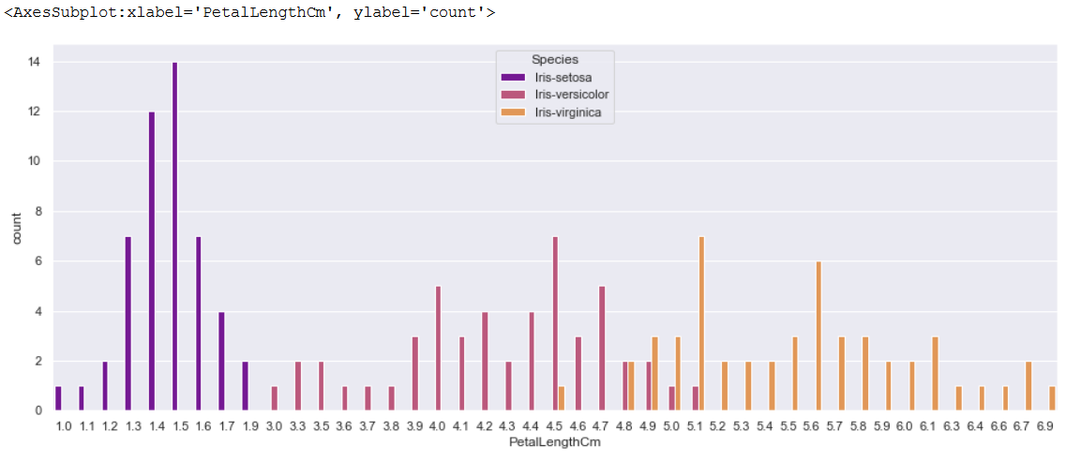
Relation: Count and PetalLengthCm

Slide 15
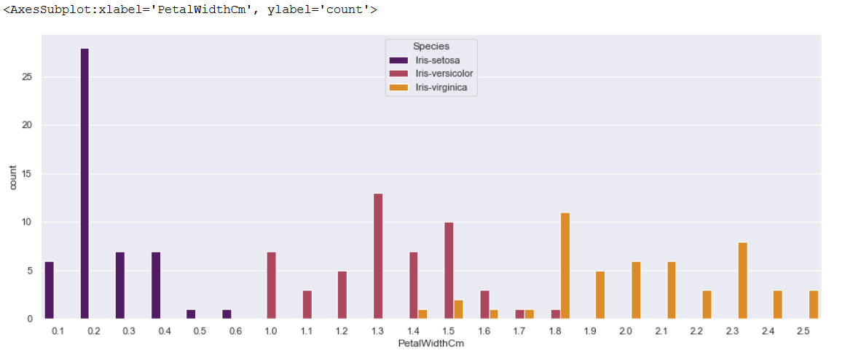
Relation: Count and PetalWidthCm

Slide 16
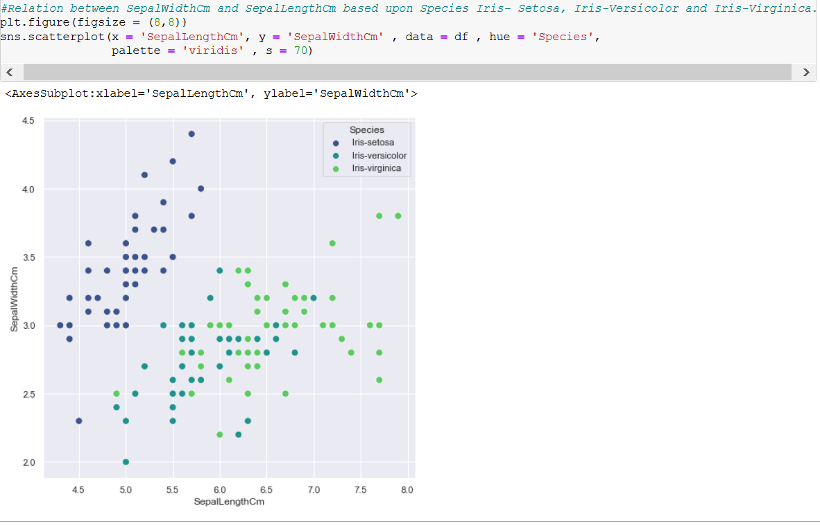
Relation:SepalLengthcm and SepalWidthcm

Slide 17
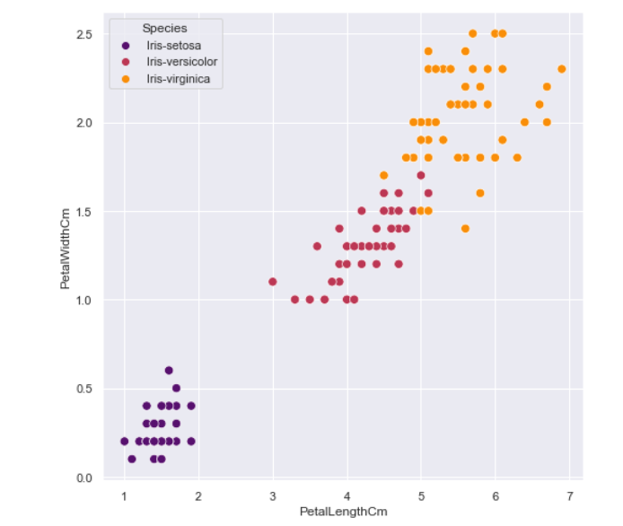
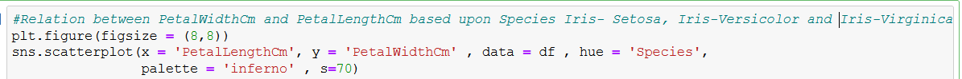
PetalLengthCm vs PetalWidthCm

Slide 18
Logistic Regression

Slide 19
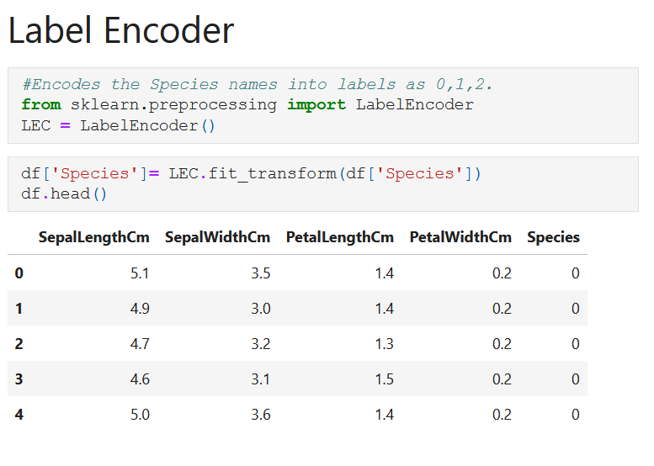
Logistic Regression: Preprocessing

Slide 20
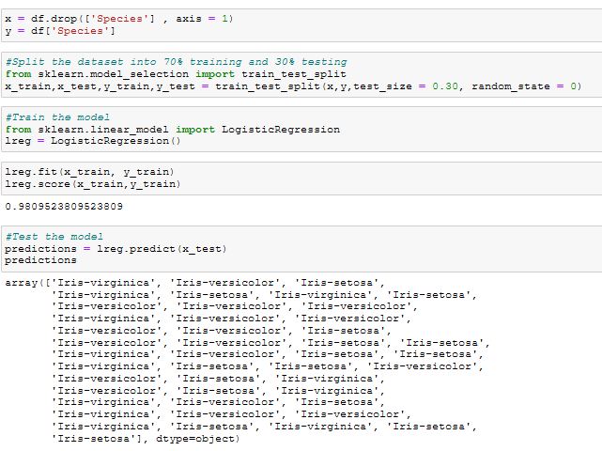
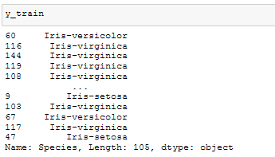
Logistic Regression: Model Evaluation

Slide 21
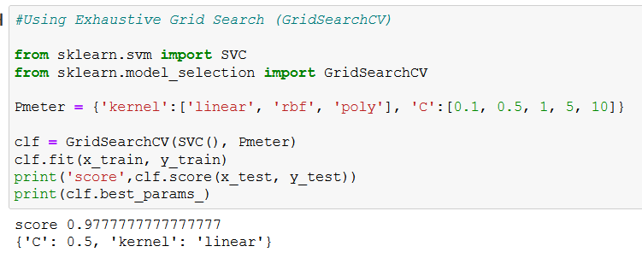
Logistic Regression: Hyperparameter Tuning

Slide 22
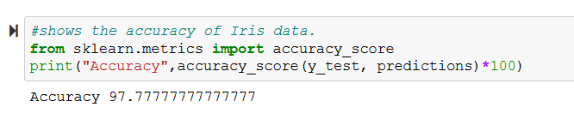
Logistic Regression: Accuracy

Slide 23
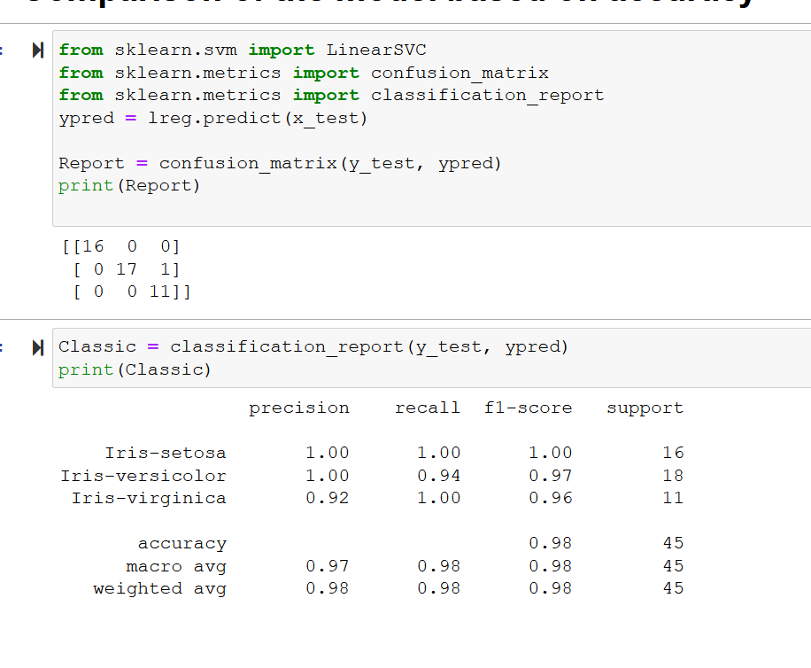
Comparison of the model based on accuracy

Slide 24
Decision Tree Classifier

Slide 25
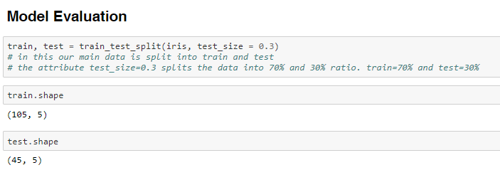
Decision Tree: Model Evaluation

Slide 26
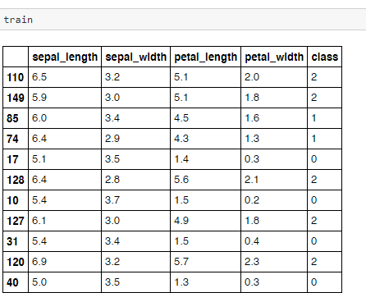
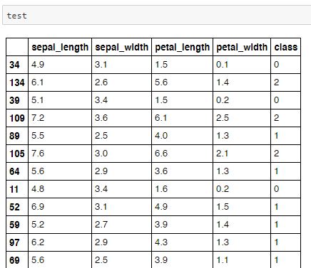
Decision Tree: Model Evaluation

Slide 27
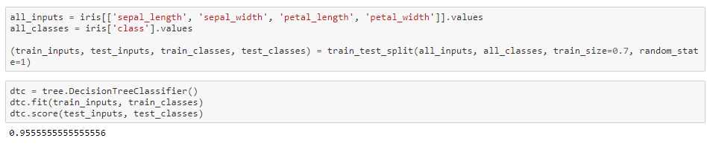
Decision Tree: Model Evaluation

Slide 28
Decision Tree: Model Evaluation

Slide 29
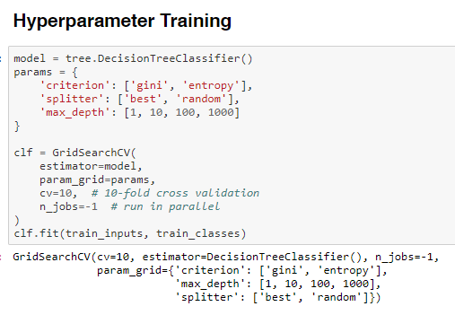
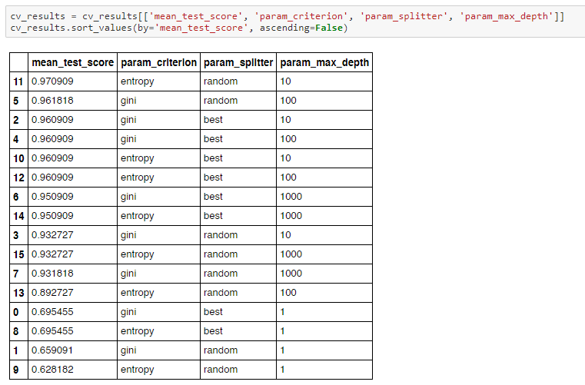
Decision Tree: Hyperparameter training

Slide 30
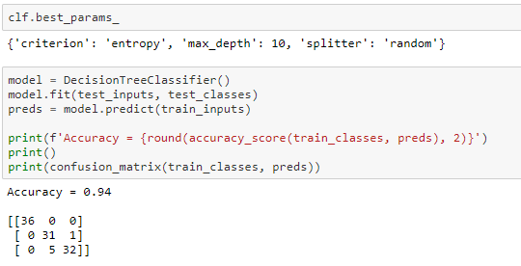
Decision Tree: Hyperparameter training and Accuracy

Slide 31
Support Vector Machine

Slide 32
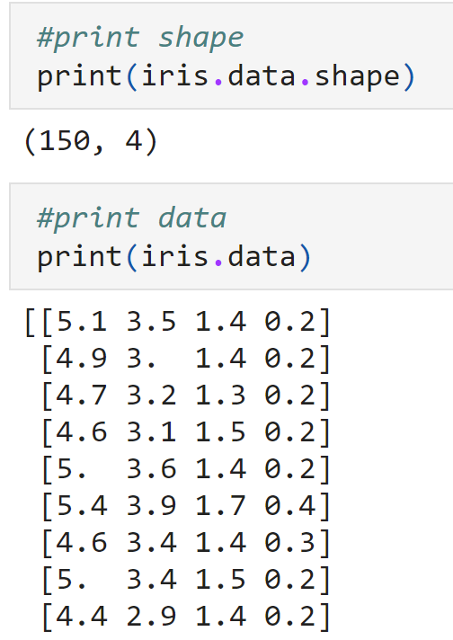
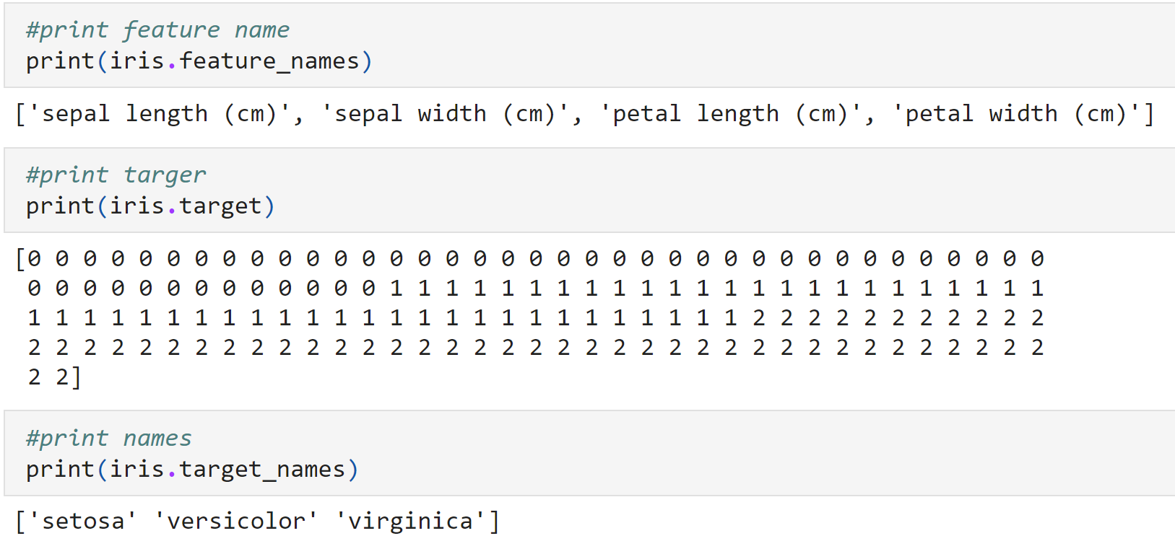
Support Vector Machine:
Model Evaluation

Slide 33
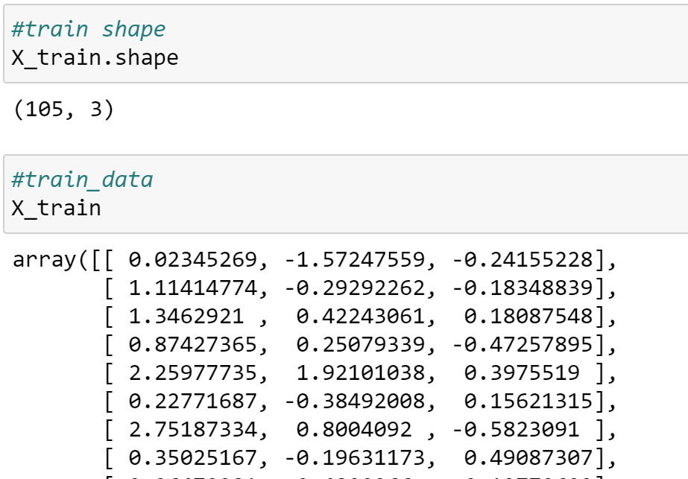
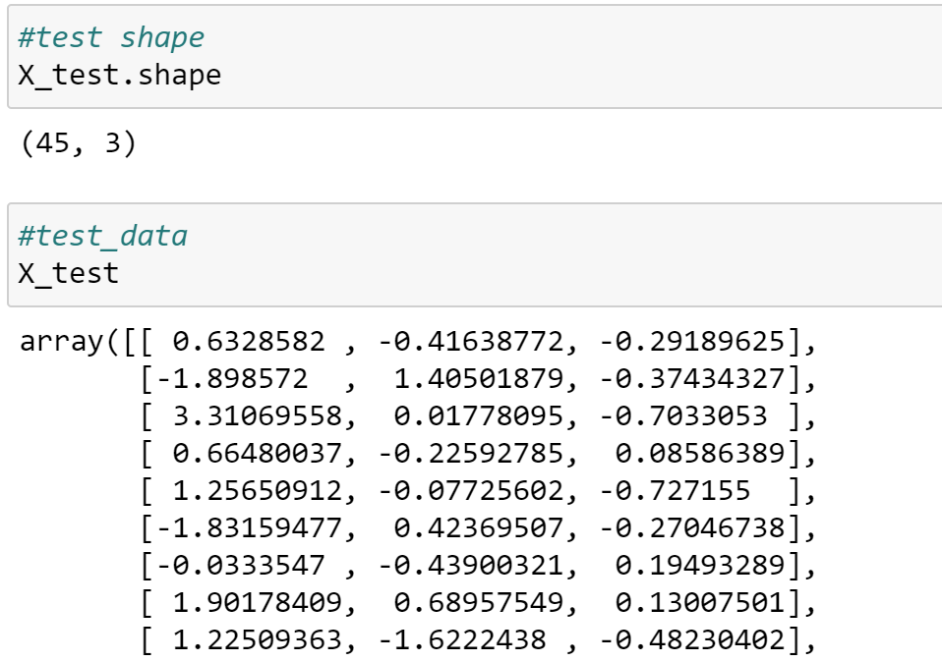
Support Vector Machine:
Model Evaluation

Slide 34
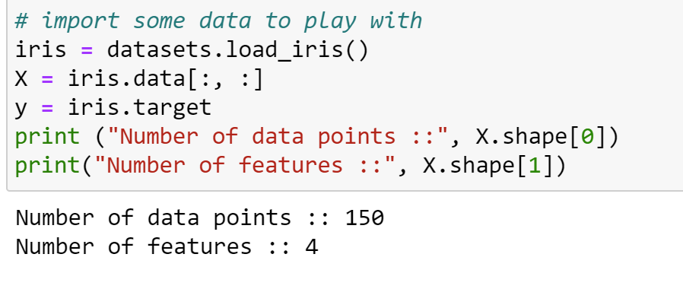
Support Vector Machine:

Slide 35
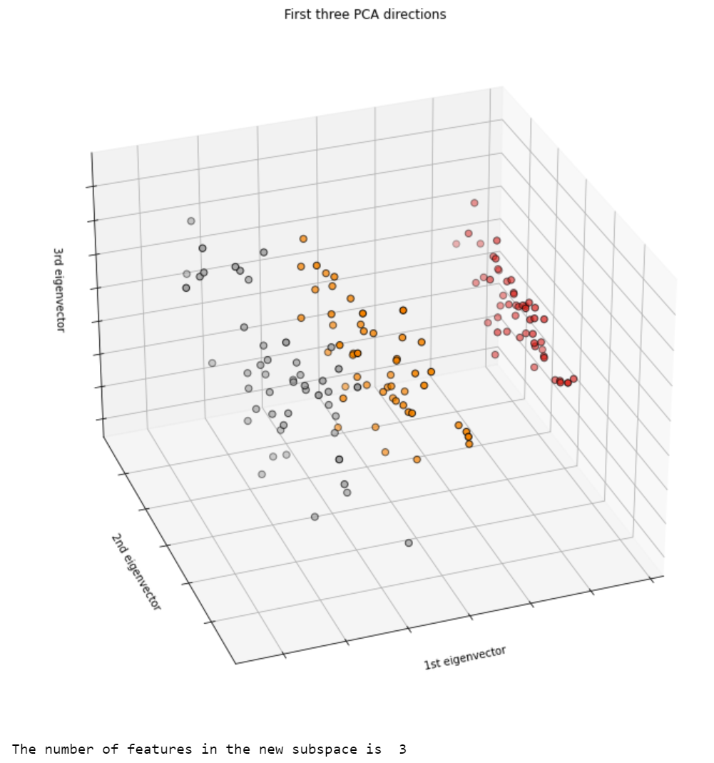
Support Vector Machine

Slide 36


Support Vector Machine: Accuracy

Slide 37


Support Vector Machine

Slide 38

Support Vector Machine

Slide 39


